Slide 1

GPT-2: Architecture and GPU Acceleration
A Deep Dive into its Inner Workings and Optimization for High Performance
Autor: Dennys Mallqui

Slide 2

Introduction
Welcome to the session.
Brief overview of the objective: Understand GPT-2 and how GPUs boost its performance.
Mention the relevance of LLMs and high-performance computing.
Conceptual reference to Andrej Karpathy's llm.c project as a C/CUDA implementation example.
Source: https://github.com/karpathy/llm.c/blob/master/README.md

Slide 3
What You Need to Know
Basic concepts of neural networks and deep learning.
Notions of Natural Language Processing (NLP).
Solid understanding of GPU architecture:
CUDA, kernels, threads, blocks, grids, warps.
Shared memory, global memory, SIMT execution.
(Optional) Basic familiarity with C programming (for the llm.c context).

Slide 4
What Will We Learn Today?
Break down the architectural components of GPT-2.
Understand how critical operations (especially attention) are parallelized for GPUs.
Appreciate the role of GPU features (parallelism, bandwidth) in acceleration.
Conceptualize CUDA implementation (e.g., llm.c).
Source: https://github.com/karpathy/llm.c/blob/master/README.md
Prepare for a conceptual practical exercise.

Slide 5
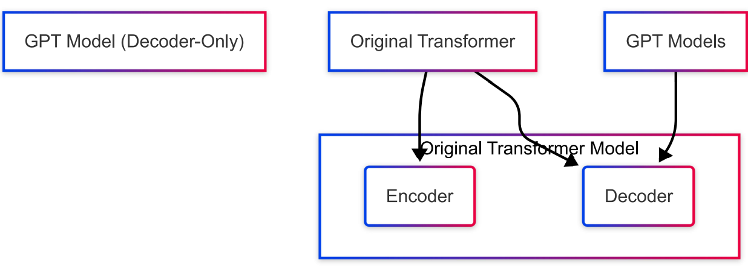
The Basics: From Transformer to GPT
Brief review of the original Transformer ("Attention Is All You Need"): encoder-decoder.
GPT: Generative Pre-trained Models based on Transformer.
Main difference: GPT primarily uses the Decoder architecture of the Transformer.
Autoregressive models: predict the next token based on previous ones.

Slide 6
Getting to Know GPT-2
Decoder-Only Architecture: Stack of decoder blocks.
Autoregressive: Sequential text generation.
Masked Self-Attention:
When predicting token i, it can only attend to tokens from 0 to i-1.
Essential for the autoregressive property.
Large Scale: Various sizes (e.g., 124M parameters in llm.c Source: https://github.com/karpathy/llm.c/blob/master/README.md up to 1.5B+).
Typical Components per Block: Embeddings, Multi-Head Attention, Layer Normalization, Feed-Forward Network.

Slide 7
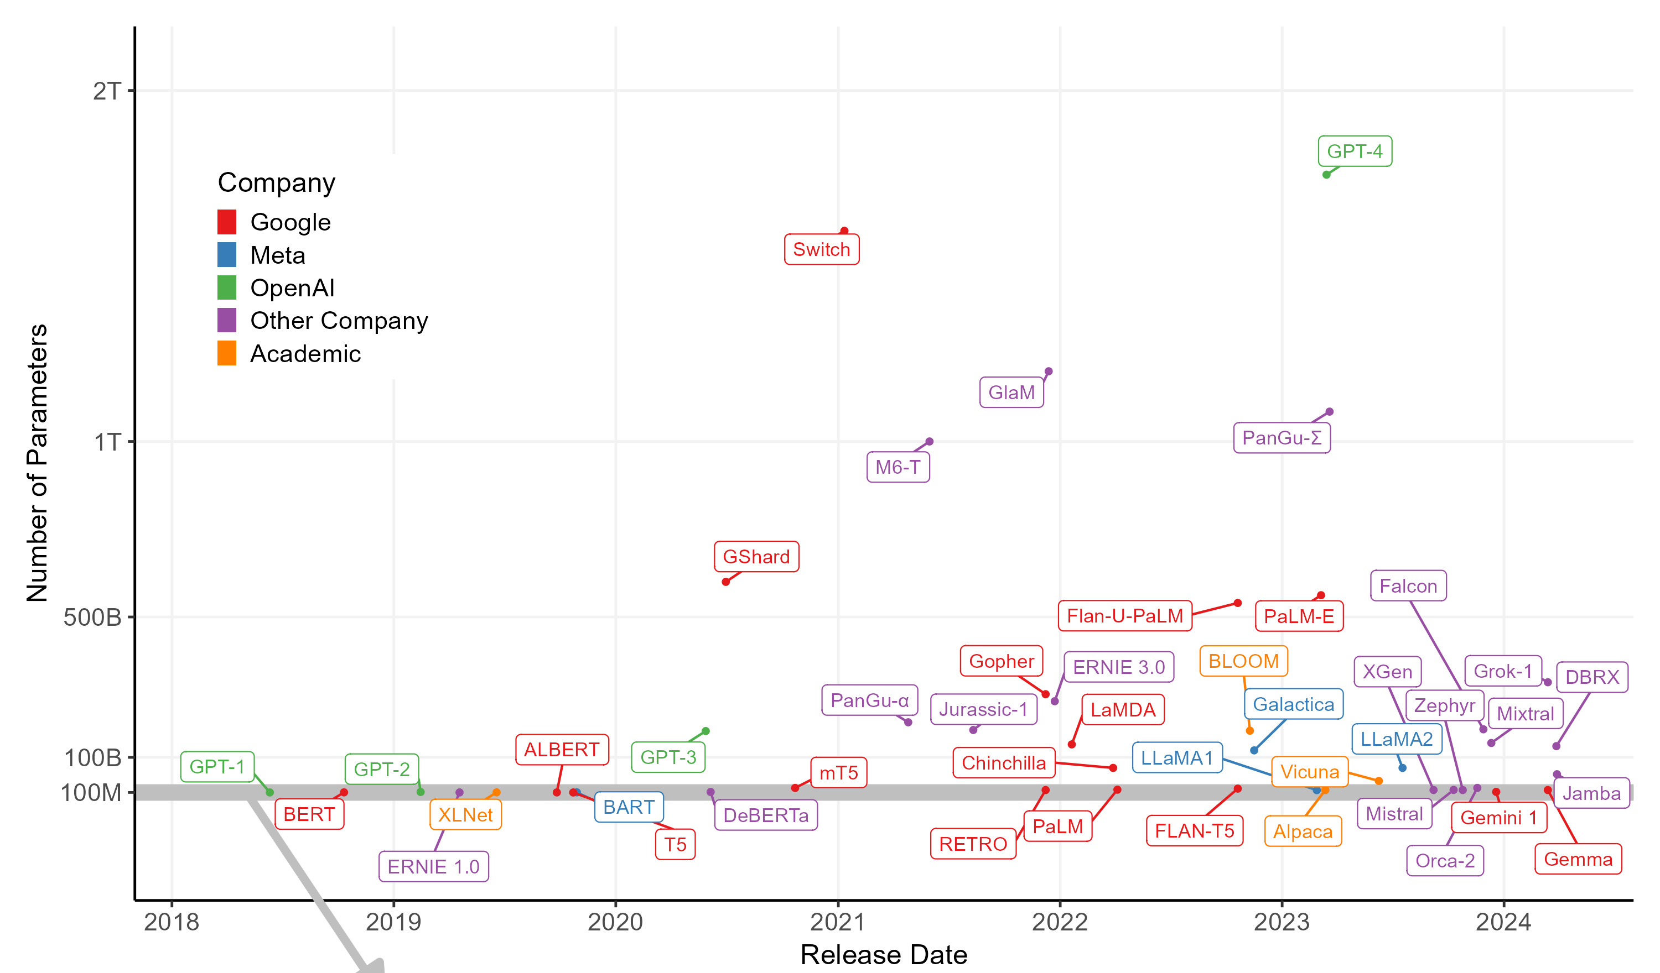
List of Model Size
Souce https://github.com/bethanyhgardner/llm-size-plot

Slide 8
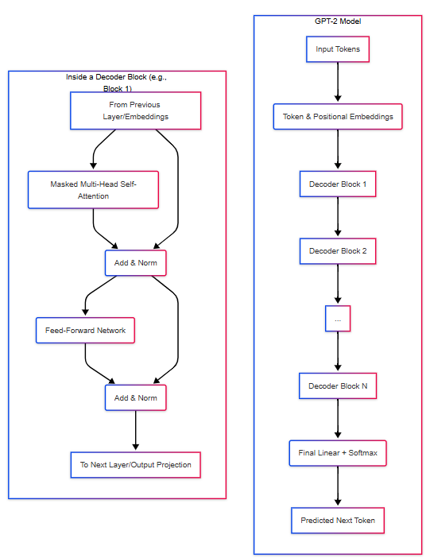
Anatomy of a GPT-2 Decoder Block
Token and Positional Embeddings.
Masked Multi-Head Self-Attention.
Residual Connection and Layer Normalization.
Feed-Forward Network (FFN).
Residual Connection and Layer Normalization.
(Repeat N times to form the complete model)
Final Linear Layer and Softmax (for prediction).

Slide 9
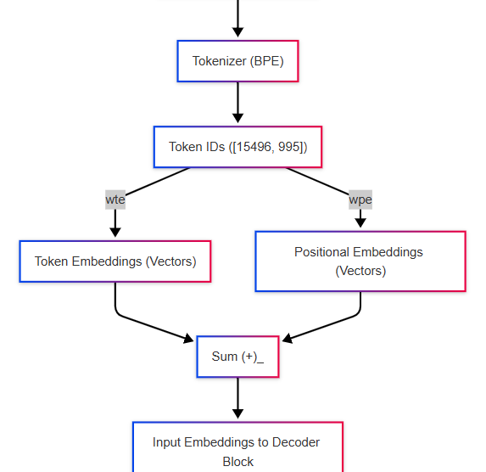
Representing Words and their Order
Tokenization: Text -> Sequence of token IDs (e.g., BPE).
(Reference: `llmc/tokenizer.h` in `llm.c` \[cite: https://github.com/karpathy/llm.c/blob/master/llmc/tokenizer.h\])
Token Embeddings (`wte`): Each token ID is mapped to a dense vector.
Positional Embeddings (`wpe`): Learned vectors indicating the token's position in the sequence.
Input to the first block: Sum of token embeddings and positional embeddings.

Slide 10
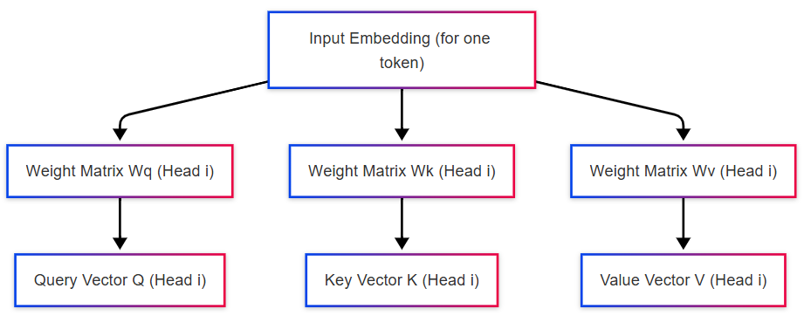
The Heart of GPT: Attention (Part 1)
Objective: Allow the model to weigh the importance of different previous tokens when processing the current token.
Process per attention head:
Linear Projections: From the input embeddings, three vectors are generated for each token:
Query (Q): Represents the current token "asking" for relevance.
Key (K): Represents how each previous token "answers" the query.
Value (V): Represents the actual content of the previous token.
(These are matrix multiplications).

Slide 11
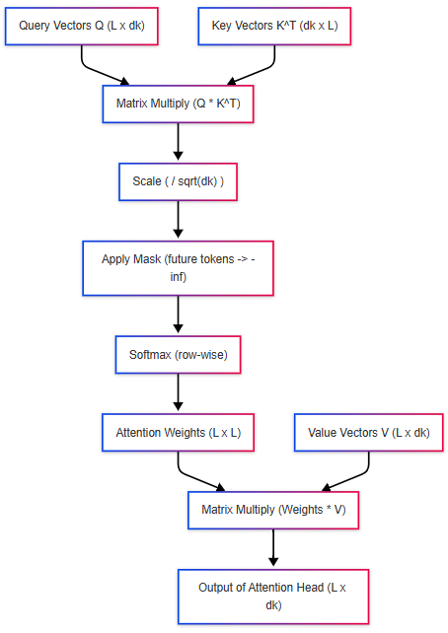
The Heart of GPT: Attention (Part 2)
Attention(Q, K, V) = softmax( (QK^T) / sqrt(d_k) ) * V
Process per head (cont.):
Attention Score Calculation: `
Scores = (Q * K^T) / sqrt(d_k)
where `d_k` is the dimension of the Key vectors.
Masking: A mask is applied so tokens cannot "see" future tokens (essential for autoregression). Scores of future tokens are set to `-infinity`.
Softmax: Applied to the masked scores to obtain attention weights (probabilities that sum to 1).
Head Output: Weighted sum of the Value vectors:
Output_head = Attention_Weights * V

Slide 12
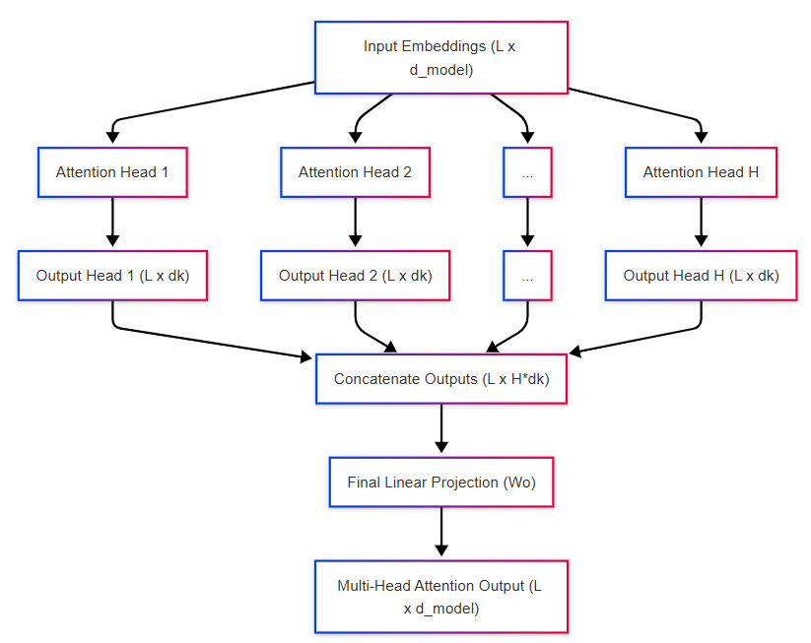
The Power of "Multi-Head"
Multiple Heads: The attention process (Q, K, V, weight calculation) is performed `H` times in parallel, each time with different learned projection matrices.
Benefit: Each "head" can learn to focus on different types of relationships or aspects of the sequence.
Concatenation and Final Projection: The outputs of all `H` heads are concatenated and then passed through a final linear layer to produce the output of the Multi-Head Attention layer.
Reference: `llmc/attention.cuh`, `dev/cuda/attention_forward.cu` in `llm.c:
https://github.com/karpathy/llm.c/blob/master/llmc/attention.cuh
https://github.com/karpathy/llm.c/blob/master/dev/cuda/attention_forward.cu

Slide 13
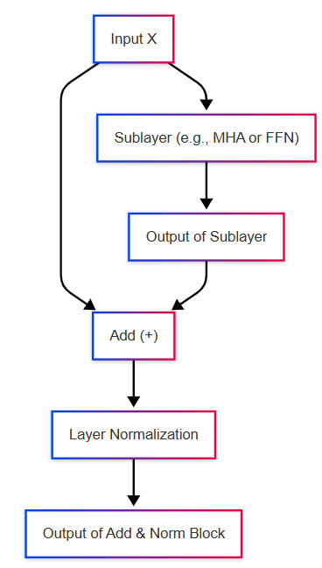
Stability and Gradient Flow
Residual Connection (Skip Connection):
The input to the sublayer (e.g., Attention) is added to its output: `Input + Sublayer(Input)`.
Helps train deeper networks by facilitating gradient flow.
(Reference: `dev/cuda/residual_forward.cu` in `llm.c`
https://github.com/karpathy/llm.c/blob/master/dev/cuda/residual_forward.cu
Layer Normalization:
Normalizes activations within the same layer for each token.
Stabilizes training and reduces sensitivity to weight initialization.
Applied AFTER the residual connection in GPT-2 (Post-LN variant, though Pre-LN is common in other models).
Reference: `llmc/layernorm.cuh`, `dev/cuda/layernorm_forward.cu` in `llm.c`
https://github.com/karpathy/llm.c/blob/master/llmc/layernorm.cuh
https://github.com/karpathy/llm.c/blob/master/dev/cuda/layernorm_forward.cu

Slide 14
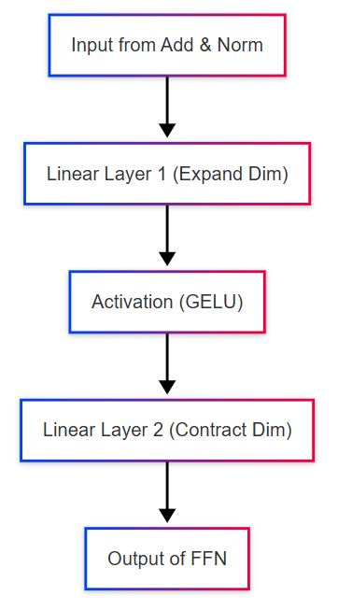
Additional Positional Processing
Applied independently to the output of each position from the previous layer (Attention + LayerNorm).
Typically consists of:
1. Linear Layer (expands dimension).
2. Non-linear Activation Function (e.g., GELU - Gaussian Error Linear Unit).
Reference: `llmc/gelu.cuh`, `dev/cuda/gelu_forward.cu` in `llm.c`
https://github.com/karpathy/llm.c/blob/master/llmc/gelu.cuh
https://github.com/karpathy/llm.c/blob/master/dev/cuda/gelu_forward.cu
3. Linear Layer (contracts dimension back to original).
Followed by another Residual Connection and Layer Normalization.

Slide 15
Why GPUs for LLMs?
LLMs require an enormous amount of computation.
GPUs are designed for massive data parallelism.
Key GPU Features for Acceleration:**
Thousands of Cores: Execute many operations simultaneously.
SIMT (Single Instruction, Multiple Threads): Groups of threads (warps) execute the same instruction on different data.
High Memory Bandwidth: Essential for feeding data to cores quickly.
Memory Hierarchy: Global, Shared, L1/L2, Registers. Efficient management is crucial.
CUDA Kernels: Functions written in C/C++ that run on the GPU, leveraging its parallelism.

Slide 16
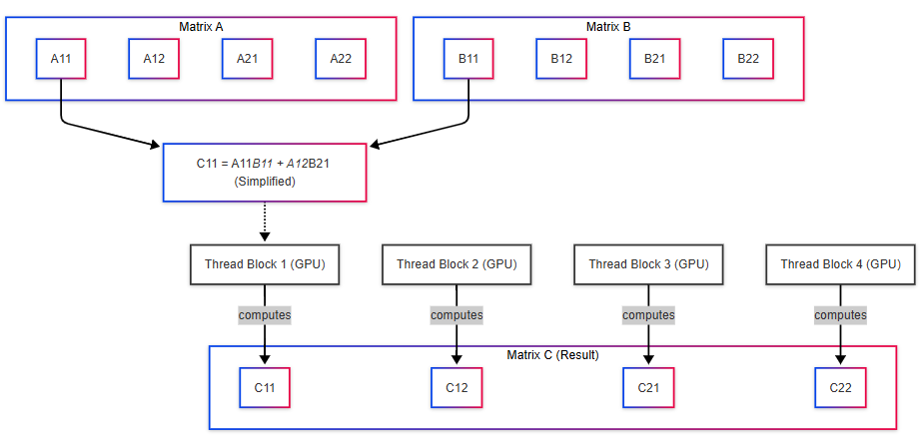
GPUs and Matrix Multiplication (GEMM)
Dense matrix multiplications are the most common and expensive operation in LLMs (QKV projections, FFN layers, output layer).
GPU Strategy (GEMM Kernel):
The output matrix is divided into tiles.
Each GPU thread block computes one tile of the result matrix.
Threads within a block collaborate:
Load tiles of input matrices into **shared memory** (faster and reduces global memory access). * Perform partial dot products and accumulate results.
Libraries like cuBLAS offer highly optimized GEMM implementations.
Reference: `llmc/matmul.cuh`, `dev/cuda/matmul_forward.cu` in `llm.c`
https://github.com/karpathy/llm.c/blob/master/llmc/matmul.cuh
https://github.com/karpathy/llm.c/blob/master/dev/cuda/matmul_forward.cu

Slide 17
Parallelizing the Attention Mechanism
Q, K, V Projections:
Are 3 matrix multiplications (Input * Wq, Input * Wk, Input * Wv).
Can be executed in parallel for all tokens and all heads.
Each multiplication is accelerated as described before (GEMM on GPU).
Score Calculation (`Q * K^T`):
One matrix multiplication per head.
Highly parallelizable:
Across heads: Each head is independent.
Within a head: Each element of the (L x L) score matrix `Score_ij = dot(Q_i, K_j)` can be computed by a thread or group of threads.
Reference: `dev/cuda/attention_forward.cu`
https://github.com/karpathy/llm.c/blob/master/dev/cuda/attention_forward.cu

Slide 18
Parallelizing the Attention Mechanism (cont.)
Masking:
Element-wise operation on the score matrix.
Perfectly parallelizable: each thread can apply the mask to one or several elements.
Softmax:
Applied row-wise to the masked score matrix.
Parallelization per row: Each row can be processed independently.
Within a row (parallel reduction):
Find row maximum.
Subtract maximum (numerical stability).
Exponentiate.
Sum exponentiated values.
Divide each exponentiated value by the sum.
Threads in a block collaborate using shared memory for these reductions.
Reference: `dev/cuda/softmax_forward.cu`
https://github.com/karpathy/llm.c/blob/master/dev/cuda/softmax_forward.cu
Weighted Sum (`Attention_Weights * V`):
Another matrix multiplication per head. Accelerated with GEMM.

Slide 19
Optimizing the Rest of the Model
Feed-Forward Networks (FFN):
Linear layers: accelerated with GEMM.
GELU activation: element-wise, highly parallel.
Reference: `dev/cuda/gelu_forward.cu`
https://github.com/karpathy/llm.c/blob/master/dev/cuda/gelu_forward.cu
Layer Normalization (LayerNorm):
Mean and variance calculation: parallel reductions per token (threads in a block collaborate).
Normalization: element-wise operation.
Reference: `dev/cuda/layernorm_forward.cu`
https://github.com/karpathy/llm.c/blob/master/dev/cuda/layernorm_forward.cu
Residual Connections: Element-wise additions, perfectly parallel.
Reference: `dev/cuda/residual_forward.cu`
https://github.com/karpathy/llm.c/blob/master/dev/cuda/residual_forward.cu
Loss Calculation (Cross-Entropy during training):
Involves a softmax and then element-wise operations and reductions. Also benefits from GPU parallelism.
Reference: `dev/cuda/crossentropy_forward.cu`
https://github.com/karpathy/llm.c/blob/master/dev/cuda/crossentropy_forward.cu

Slide 20
Let's Get Hands-On! (Conceptual)
Identify Key Kernels:
Explore `dev/cuda/` in `llm.c`.
List critical `.cu` files for GPT-2's forward pass.
Describe their role and expected type of parallelism.
Deep Dive into Attention Kernel (`dev/cuda/attention_forward.cu` source: https://github.com/karpathy/llm.c/blob/master/dev/cuda/attention_forward.cu:
How would you assign threads/blocks for `Q*K^T`?
How would shared memory be used?
How are multiple heads handled in parallel?
Analyze a Training Script (e.g., `scripts/run_gpt2_124M.sh` source: https://github.com/karpathy/llm.c/blob/master/scripts/run_gpt2_124M.sh
Identify parameters related to GPU, batch size, sequence length.
Predict their impact on GPU memory, parallelism, and training time.
(Bonus) Profiling Thought Experiment:
If you used a CUDA profiler (Nsight), what metrics and kernels would you look for to identify bottlenecks?

Slide 21
Conclusions and Q&A
Recap of GPT-2 architecture and its key components.
Critical importance of GPU acceleration for the feasibility of LLMs.
Attention is a computational bottleneck but highly parallelizable.
Projects like `llm.c` offer an educational view of these implementations.
Source: https://github.com/karpathy/llm.c/blob/master/README.md

Slide 22
GPT-2: Architecture and GPU Acceleration
A Deep Dive into its Inner Workings and Optimization for High Performance
Autor: Dennys Mallqui
Email: dennys.mallqui@gmail.com

